Slide 1

EMPLOYEE DATA ANALYTICS USEING EXCEL
NAME: K.GAYATHRI
RESISTOR NO:asunm110312201328
DEPARTMENT:COMMERCE
COLLEGE:D.R.B.C.C.C.HINDU COLLEGE

Slide 2
PROJECT TITTLE
EMPLOYEE PERFORMANCE ANALYSIS USEING EXCEL

Slide 3
AGENDA
1.PROBLEM STEATMENT
2.PROJECT OVERVIEW
3.END USERS
4.OUR SOLUTION AND PROPOSITION
5.DATASET DESCRIPTION
6.MODELLING APPROACH
7.RESULTS AND DISCUSSION
8.CONCULSION

Slide 4
PROBLEM STATEMENT
Turnover by Department and Location: Determine which departments and locations have the highest turnover rates and identify any trends related to these factors.Turnover by Joining Year and Experience: Assess how turnover rates vary with the number of years since joining and the level of experience of employees.Gender-Based Turnover Trends: Explore if there are any significant differences in turnover rates between male and female employees.Impact of Salary on Turnover: Examine whether higher or lower salaries correlate with higher turnover rates

Slide 5
PROJECT OVERVIEW
Time Span:The data spans from 2012 to 2018.Key Metrics:Total Employees: 42Total Turnover: $14,766,204Average Turnover per Employee: $351,571.52Gender Distribution:Male: 27 employeesFemale: 15 employeesWork Locations:New Delhi: 11 employeesBangalore: 22 employeesPune: 9 employeesDepartments:Sales: 14 employeesFinance: 13 employeesQuality: 14 employeesPurchase: 3 employeesTurnover by Department:Sales: $4,370,080Finance: $5,453,492Quality: $4,262,940Purchase: $707,580Turnover Trends:Highest Turnover Year: 2016 ($2,599,920)Lowest Turnover Year: 2018 ($1,577
Title

Slide 6
END USERS
Title
Highest Turnover:Remy Sweeney: 1,200,000 (Pune, Sales, 2016)Yara Keith: 961,100 (Bangalore, Finance, 2016)Karter Bonilla: 961,100 (Bangalore, Quality, 2018)Highest Turnover by Department:Finance: Yara Keith (961,100), Kelsey Norton (840,002), Coen McBride (754,120)Sales: Remy Sweeney (1,200,000), Kristian Castro (580,000), Jagger Valenzuela (580,000)Highest Turnover by Location:Bangalore:Remy Sweeney (1,200,000)Yara Keith (961,100)Karter Bonilla (961,100)New Delhi:Mohammad House (451,360)Justice Perez (254,110)Amilith Randall (256,130)Pune:Romina Gibson (621,520)Cayson Meyer (895,412)Sara McMillan (754,120)
Title
Text
Title
Text
Title
Text

Slide 7
OUR SOLUTION AND PROPOSITION
Turnover by Department:Sales: High turnover with many employees leaving after 1-2 years, especially in Bangalore and Pune. Notable high turnover values and number of exits.Finance: Relatively stable with few high turnover instances. Predominantly based in Bangalore with some in Pune.Quality: Significant turnover, particularly in Bangalore and Pune. High turnover values for several employees.Purchase: Limited to New Delhi with high turnover values.Turnover by Location:Bangalore: Consistent high turnover across departments with noticeable high turnover values.Pune: Significant turnover, particularly in sales and quality.New Delhi: Higher turnover in finance and purchase, but less in sales compared to Bangalore and Pune.
Title
Text
Text

Slide 8
DATASET DESCRIPTION
Name: Employee's name.Joining Year: Year the employee joined the company.Gender: Gender of the employee.Turnover: Amount of turnover generated by the employee.Experience: Number of years the employee has worked.Work Location: City where the employee is based.Department: Department the employee works in (e.g., sales, finance, quality, purchase).
Title

Slide 9
MODELLING APPROACH
Data Cleaning and PreparationStandardise Data: Ensure all data entries are consistent in format. For example, standardise locations and departments.Handle Missing Data: Address any missing or inconsistent values.2. Descriptive StatisticsTurnover Trends: Calculate average turnover per year, department, and work location.Experience Analysis: Average experience of employees who left versus those who stayed.3. Turnover Rate CalculationOverall Turnover Rate:

Slide 10
DISCUSSION
Turnover Trends:The turnover amounts vary widely, with some employees having significantly higher turnover figures than others. For example, Remy Sweeney and Kristian Castro from 2016 have turnover amounts of 1,200,000 and 580,000, respectively, which are much higher compared to many others.Experience and Turnover:There seems to be no direct correlation between the number of years of experience and turnover amount. For instance, employees with the same amount of experience can have very different turnover amounts.Department Analysis:The finance department has several high turnover figures, such as Yara Keith and Delaney Vaughn from 2016. The sales department also shows high turnover, particularly with employees like Remy Sweeney and Kristian Castro.
Turnover Trends:The turnover amounts vary widely, with some employees having significantly higher turnover figures than others. For example, Remy Sweeney and Kristian Castro from 2016 have turnover amounts of 1,200,000 and 580,000, respectively, which are much higher compared to many others.Experience and Turnover:There seems to be no direct correlation between the number of years of experience and turnover amount. For instance, employees with the same amount of experience can have very different turnover amounts.Department Analysis:The finance department has several high turnover figures, such as Yara Keith and Delaney Vaughn from 2016. The sales department also shows high turnover, particularly with employees like Remy Sweeney and Kristian Castro.

Slide 11
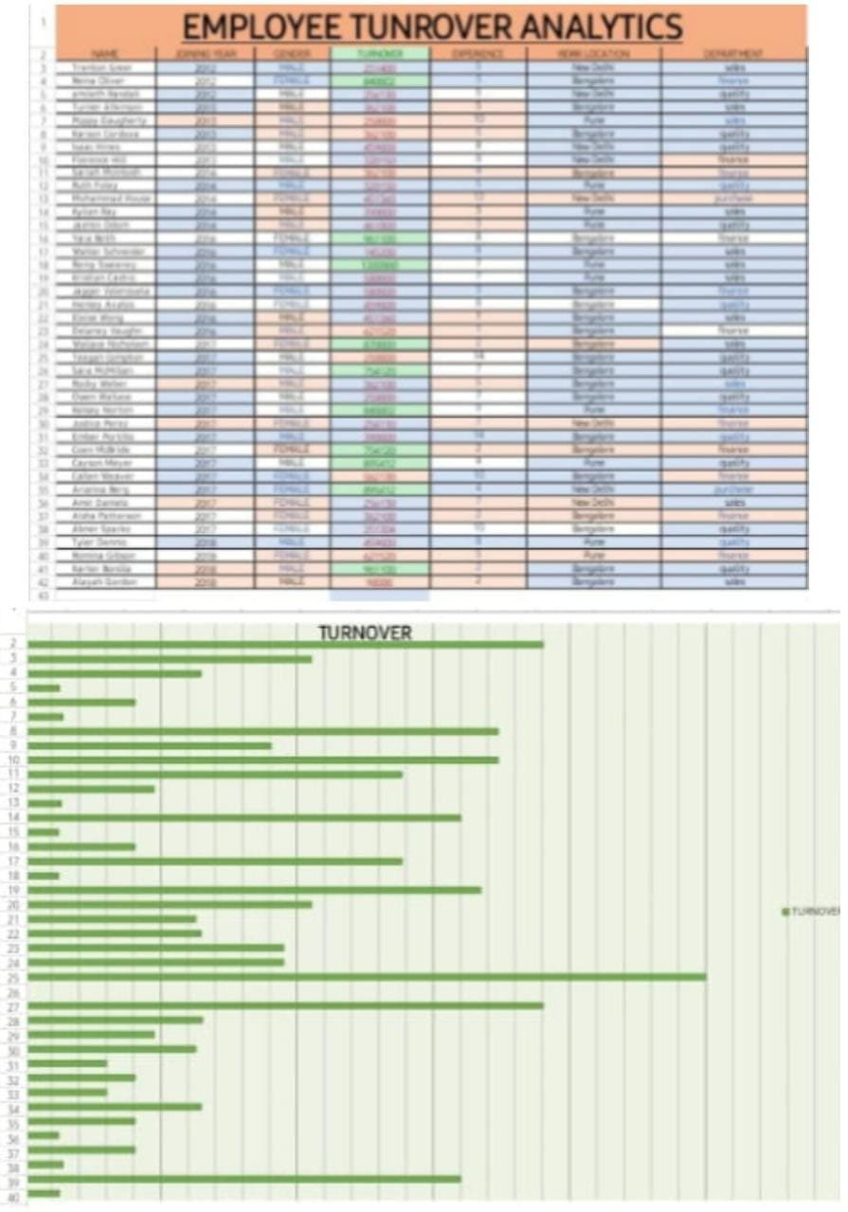
RESULT

Slide 12
CONCULSION
High Turnover Figures:Several employees have notably high turnover amounts, particularly from the finance and sales departments, such as Remy Sweeney (1,200,000) and Kristian Castro (580,000) from 2016. This indicates that the company may have significant financial transactions or investments in these roles.Department Insights:The finance and sales departments feature prominently with high turnover figures. This suggests these departments may be critical to the company's financial performance or involve large-scale transactions.The quality department also shows considerable turnover, especially among employees with extensive experience.Location Analysis:Bangalore has the highest number of employees with substantial turnover amounts, particularly in finance and sales. This could reflect Bangalore’s role as a major operational hub.Pune also shows high turnover but more concentrated in sales and quality roles.

Slide 13
Thank you

